Slide 1
Covid Vaccine Facilitator
Team Members:
Sailaja Pattadari
Ramya Reddy Guda
Sahithya Edla
Rakesh Dasapathri
Target Market: COVID VACCINATION
Value Propositions:
Easy access to get vaccinated

Slide 2
Covid Facilitator
It facilitates all peoples to maintain their record regarding Covid vaccination. It provides peoples a quick and easy access to the vaccination centers. It also track all type of record of vaccination centers to avoid any difficulties.

Slide 3
PROBLEM
The main issue is to manage the population for vaccination. Vaccination is necessary for everyone. So, for this purpose every vaccination centers as well as the Individual face many problems. Some are overloaded and some have only few members for Vaccination.

Slide 4
Solution:
It facilitates all the users to maintain their record regarding Covid vaccination.
It provides people a quick and easy access to the vaccination centers.
It also track all type of record of vaccination centers to avoid any difficulties.
A chatbot will be implemented having AI support
Chatbot is responsible for all reservations
AI based chatbot consider all factors including limits and age factor etc.
All data will be generated in the backend according to chatbot.
Generated data will be used to generate a brief report

Slide 5
Key Winning Features
System have two main modules.
a. User or Patient Portal
b. Admin Portal
User module have two basic features.
a. AI Chatbot Registration Module
b. Query Portal
Admin module have two basic features.
a. Report Generator
b. Admin controls

Slide 6
Concept and Justifications of solution
Cooking Frenzy is a latest project which launched recently on Google app store. Company Spent 1.2 years on this project.
The game is under Beta testing.
Vaccine become need these days.
It is very difficult to reserve your vaccination in vaccination center.
It is also difficult for vaccination centers to serve all population at once.
This application facilitates everyone to reserve their seats accordingly.
People can easily reserve specific vaccine for their reservation.
Vaccination centers also have data to see all reservations,
This application helps to avoid any mess in the vaccination centers.
The reports generated by the application helps to take decisions for further lockdown or SOP’s Implementation.

Slide 7
Current Status
We have two basic modules in the whole system.
User or Patient Module
Admin Module
Firstly, we have implemented user side functionalities. We implemented complete solution to register and check necessary information and then we did the testing and then finally designed admin portal and user’s or patient portal.

Slide 8
User Module
AI Chatbot Registration
Cooking Frenzy is a latest project which launched recently on Google app store. Company Spent 1.2 years on this project.
The game is under Beta testing.
AI Chatbot will ask the necessary information about the user.
Save the information and reserve the appointment accordingly.
Reservation information will be used for the report generation.
Query Portal
User can contact admin using this portal.
This will facilitate the user for other basic functionalities.

Slide 9
Admin Module
Report Generator
Reservation's data will be used for report generation having all necessary information.
Report will be used for SOP’s related decisions.
It will show result in graphical manner.
Admin Control
Admin can resolve the queries requested by the user or patients.
Admin have access to see the reservations.
Admin have other main basic controls.

Slide 10
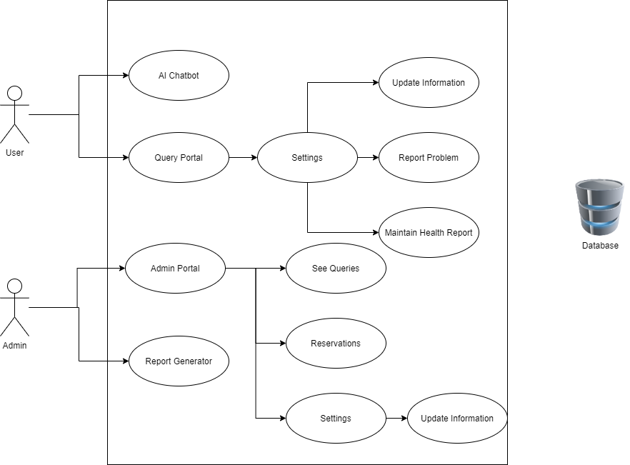

Slide 11
Prototype Demo

Slide 12
How are we going to make money?
Ads are the main sources of earning
It will ask the user if he or she wants to remove add and see and maintain record after vaccination then should buy subscription.

Slide 13
Market Research on current Offerings
This will adopt by private vaccination centers as well as Public sector vaccination centers.
Application have two ends; one is for peoples and other is for Administration.
Through the application distribution platforms like play store becomes the backbone to spread the system.
Vaccination making companies also encourage the use of Vaccine facilitator.

Slide 14
Target Market and Value Proposition
All users and vaccination centers are the vital target.
Vaccination becomes need and there is no related application.
It facilitates all peoples to maintain their record regarding Covid vaccination.
It provides peoples a quick and easy access to the vaccination centers.
It also track all type of record of vaccination centers to avoid any difficulties.
All peoples will use this application to perform vaccination and further queries.
Cooking Frenzy is a latest project which launched recently on Google app store. Company Spent 1.2 years on this project.
The game is under Beta testing.

Slide 15
Business Models and Development Approach

Slide 16
Business Model –Earning Point of View
Cooking Frenzy is a latest project which launched recently on Google app store. Company Spent 1.2 years on this project.
The game is under Beta testing.
Application have two types of earning mechanism
Ads related earnings
There is no restriction for all to pay and avail the services. Ads will be shown after specific task performance. This free service will not provide Certification.
Subscription based earning
Subscription will facilitates the user ad free environment and also generate an official certificate of vaccination after vaccination done. Also provide doctor assistance in any case.

Slide 17
Team Members Expertise and Contributions
01
Sailaja Pattadari
Mobile applications Development Expertise
Designed whole application for user end.
02
Rakesh Dasapathri
Mobile applications Development Expertise
Designed whole application for Administration end.
03
Sahitya Edla
AI Bot Development Expertise
Designed AI bot assistance to operate all functionalities..
04
Ramya Guda
Report Analyst and Subscription method Designing Expertise
Designed report generator and design subscription mechanism

Slide 18
Conclusion (Scale up)
As you all know, the increased threat from different variants is avoidable only with proper vaccination.
To scale up this project for the easy and pain free vaccination procedure is much needed with the given situation.
Patients and users will easily find the vaccination centres
AI Chatbot facilitates the user for easy reservations and provide real time information
The report generated by the system will hep to take required actions.

Slide 19
Thank You

